Slide 1
A summary of the 2016 ESWG paper challenge and questionnaire
Daniel Kling
ESWG Budapest, 2 September 2016
daniel.kling@fhi.no

Slide 2
Agenda
Introduction
General
Marker systems
Statistical evaluation
Sequencing
Paper challenge
Next year

Slide 3
Introduction
43 labs participated
Questionnaire
Divided into five different sheets
Paper challenge
Four parts
Concept taken from a real case
User-friendly data
21 labs did all the four parts!
Generally very consistent results for Part 1

Slide 4
General – Summary
Case type | #Labs | #Accredited | #Cases
Paternity | 38 | 28 | 10-5,000
Kinship | 32 | 27 | 2-360
Crime cases | 23 | 19 | 2-30,000
Identification | 26 | 21 | 2-1,700
DNA databasing | 13 | 12 | 493-133,253
Zygosity of twins | 11 | 10 | 1-56
Bonemarrow follow up | 2 | 1 | 291 and 490
Diagnosis of genetic disorders | 4 | 0 | 46-15,315
Other (Phenotyping, species determination etc) | 5 | 2 | 6-102

Slide 5
General – Accreditation
Do you participate in other proficiency testing?
47% answered No
53% answered Yes
Examples
Yes (CAP/AABB, Nordic program, SNP-program)
Yes (AABB CAP)
Yes (CTS)
Yes (National programme)
Yes (CH Ringversuch)
Yes (GEDNAP)
Yes (ČSSFG MPZ)
Yes (Baur/DGAB)

Slide 6
General – Subcontractor
Do you provide services as a subcontractor?
79% answered No
21% answered Yes
Examples
Yes (more than 20 medical laboratories in Russian Federation)
Yes (STR for bone marrow transplant hospitals)
Yes (capillary electrophoresis of human identification multiplex PCR products)
Yes (additional marker sets f.i. CS7 (Promega) or Investigator HDPlex (Qiagen))
Yes (mtDNA, Y testing)
Yes (Relationship and identity testing)
Yes (STRs, SNPs, MtDNA)
Yes (LR calculation)

Slide 7
General – Subcontractor
Do you purchase services from others (subcontractors)?
75% answered No
25% answered Yes
Examples
Yes (mtDNA)
Yes (DNA Analysis at Kings)
Yes (ADDITIONAL MARKERS)
Yes (if necessary HDPlex)

Slide 8
Marker systems
Case type | #Markers | Kit type
Paternity | 19.5 | 100% commercial
Kinship | 21.5 | 100% commerical
Crime cases | 16 | 100% commerical
Identification | 16 | 100% commerical
DNA databasing | 16.5 | 100% commerical
Zygosity of twins | 16 | 100% commerical
Bonemarrow follow up | 15 | 75% commerical
Diagnosis of genetic disorders | 5 | 25% commerical
Other (Phenotyping, species determination etc) | 15 | N/A

Slide 9
Marker systems – Additional
Examples
IDFL
YfilerPlus
ArgusX12
HIDIonAmpliSeqIdentityPanel
Autosomal
Y markers
X markers
Y-STRs
X-STRs
mtDNA
Hdplex

Slide 10
Sequencing
Do you perform 2nd generation sequencing (NGS)?
23% answered ”Yes”
7% answered ”Planning to”
2% answered ”In process
42% answered ”No”

Slide 11
Sequencing – Platforms
Platform | #Labs
Illumina MiSeq | 6
PGM (Ion torrent) | 3
Sanger (various platforms) | 8
Pyrosequencing 454 | 1

Slide 12
Sequencing – Applications
Examples
Kinship
preimplantation genetic screening
Non-invasive prenatal testing
HV1 and HV2 D-loop
Research and forensic casework
Y hg's, mtDNA hg's and SHAFs (short hypervariable autosomal fragments)
different applications in diagnosis of infectious desease
Supplementary testing in paternity/kinship cases
hereditary mutation testing
DVI, lineage

Slide 13
Statistical evaluation - Software
Software | #Labs | Validated
Familias | 29 | Lab: 18 / Sup: 8
DNA View | 7 | Lab: 3 / Sup: 4
Excel worksheet | 14 | Lab: 10 / Sup: 2
Programme by Max Baur | 2 | Lab: 0 / Sup: 2
Popstats | 2 | Lab: 0 / Sup: 1
FamLinkX | 7 | Lab: 4 / Sup: 2
FamLink | 2 | Lab: 2 / Sup: 0
Other (Include LIMS, Genemapper and software for mixture interpretation) | 16 | Lab: 10 / Sup: 6

Slide 14
Statistical evaluation – Report
What do you report (PI/W/EM/Other)?
72% answered ”PI”
83% answered ”W”
9% answered ”EM”
5% answered ”LR”
Some labs report several of the above
2/43 report three
24/43 report two
17/43 report one

Slide 15
Statistical evaluation – Silent alleles
How do you treat the presence of silent alleles?
23% answered Never
9% answered ”Always for homozygotes”
51% answered ”Only for opposite homozygotes”
14% answered ”Other”
Examples of other answers
X (we use multiple PCR kits from different suppliers)
X (Only when single inconsistency)
X (depending on whether the electropherogram indicates a possible null allele)

Slide 16
Statistical evaluation – Mutations 1
Do you use different probabilities for one, two step and n step mutations?
63% answered ”Yes”
19% answered ”No”
7% answered ”Only one steps are considered”
14% answered ”Other”
Examples of comments
X (1 step 10 time more frequent than 2 steps… Brenner's formulas)
X (0,1)
X (µ for 1-step, µ2 for 2-step (>2 steps not considered))
X (We use lower mutation probabilities for multi-step inconsistencies)
X (Genoproof used for mutation calculation)
X (as recommended by the statistical programme we use)

Slide 17
Statistical evaluation – Mutations 2
When do you consider an inconsiency as a mutation?
74% answered ”Yes”
19% answered ”Always”
2% answered ”Never”
12% answered ”One step”
19% answered ”Other”

Slide 18
Statistical evaluation – Rare alleles
How do you estimate the frequency of rare alleles? (N denotes the size of the population database)
2% answered ”DNE”
21% answered ”Fixed”
21% answered ”(x+1)/(N+1)”
35% answered ”5/(2N)”
2% answered ”1/(2N)”
2% answered ”5/N”
5% answered ”3/N”
7% answered ”1/N”
Range for fixed frequencies
0.05-0.001

Slide 19
Statistical evaluation – Database unavailable
How do compute the LR when no relevant population frequency database if available?
5% answered ”Do not compute”
70% answered ”Use the closest available”
19% answered ”Use standard database”
9% answered ”Report the most conservative from all available databases”

Slide 20
Statistical evaluation – Theta/subpopulation corrections
When do you account for subpopulation effects?
63% answered ”Never”
33% answered ”When subpopulation is known”
9% answered ”Always”
Examples of thetas
Always (0,01)
Always (0.005 for the Icelandic population, 0.01 for others)
Always (1 % or 3 %)

Slide 21
Statistical evaluation – Linkage
How do you handle linked markers?
26% answered ”Exclude one marker”
28% answered ”Linked markers not used”
21% answered ”Adjusted (Dedicated software/manual)”
28% answered ”Not accounted for”
0% answered ”Other”

Slide 22
Paper challenge
The challenge was divided into four parts with increasing complexity
Setup reflected a real case
Part 1 – A standard paternity case (trio)
Few deviating results
All conclusions in favor of paternity
Large LR
Parts 2-4 (Incestual relations)
33 labs did part 2, 26 did part 3 and 23 did part 4
Some labs reported that software could not handle the loops
Mutations necessary to explain the data in parts 3 and 4

Slide 23
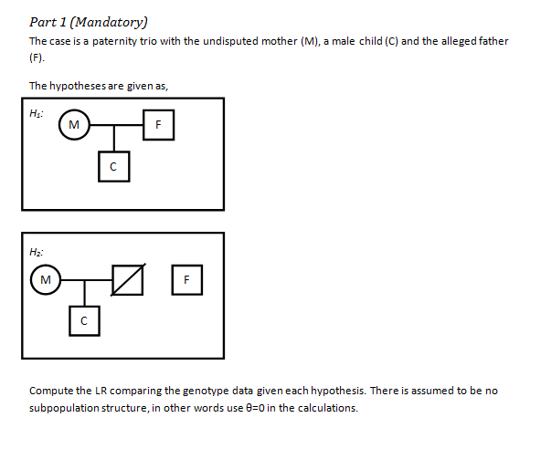
Paper challenge – Part 1

Slide 24
Paper challenge – Part 1
Autosomal STRs | Mother (M) |  | Child (C ) |  | Father (F)
 | A1 | A2 | A1 | A2 | A1 | A2 | Formula |  | LR by hand | LR in Familias
D3S1358 | 17 | 18 | 17 | 17 | 16 | 17 | 1/2p17 |  | 1.923076923 | 1.920783756
TH01 | 8.3 | 9.3 | 9.3 | 9.3 | 7 | 9.3 | 1/2p9.3 |  | 9.803921569 | 9.801895425
D21S11 | 28 | 28 | 28 | 30 | 28 | 30 | 1/2p30 |  | 2.032520325 | 2.028245569
D18S51 | 14 | 22 | 14 | 22 | 14 | 16 | 1/2(p14+p22) |  | 5.649717514 | 5.630992744
D5S818 | 11 | 11 | 11 | 11 | 11 | 13 | 1/2p11 |  | 2.057613169 | 2.054017102
D13S317 | 12 | 12 | 12 | 13 | 12 | 13 | 1/2p13 |  | 3.759398496 | 3.752783115
D7S820 | 10 | 12 | 10 | 12 | 10 | 10 | 1/(p10+p12) |  | 1.897533207 | 1.894252297
D16S539 | 12 | 13 | 11 | 13 | 11 | 12 | 1/2p11 |  | 1.666666667 | 1.664897109
CSF1PO | 12 | 12 | 12 | 12 | 11 | 12 | 1/2p12 |  | 1.5625 | 1.560190031
VWA | 15 | 15 | 13 | 15 | 13 | 15 | 1/2p13 |  | 71.42857143 | 71.18798368
D8S1179 | 13 | 14 | 14 | 14 | 14 | 15 | 1/2p14 |  | 1.851851852 | 1.84929826
TPOX | 6 | 8 | 6 | 11 | 6 | 11 | 1/2p11 |  | 2.173913043 | 2.173565685
FGA | 23 | 24 | 23 | 24 | 22 | 23 | 1/2(p23+p24) |  | 1.436781609 | 1.436384789
D19S433 | 13 | 13.2 | 13 | 13 | 13 | 15.2 | 1/2p13 |  | 2.173913043 | 2.171024457
D2S1338 | 21 | 22 | 22 | 22 | 21 | 22 | 1/2p22 |  | 3.703703704 | 3.699592594
D10S1248 | 14 | 15 | 13 | 14 | 13 | 15 | 1/2p13 |  | 1.851851852 | 1.847314837
D1S1656 | 16 | 16.3 | 16 | 17 | 16 | 17 | 1/2p17 |  | 13.51351351 | 13.48237989
D22S1045 | 15 | 17 | 17 | 17 | 15 | 17 | 1/2p17 |  | 5 | 4.990400227
D2S441 | 10 | 15 | 10 | 15 | 10 | 14 | 1/2(p10+p15) |  | 4.545454545 | 4.540434211
D12S391 | 17 | 25 | 23 | 25 | 17 | 23 | 1/2p23 |  | 10 | 9.979805482
SE33 | 17 | 24.2 | 24.2 | 33.2 | 24.2 | 33.2 | 1/2p33.2 |  | 100 | 99.1317682
 |  |  |  |  |  |  |  |  | 1.5657E+13 | 1.503160287000E+13

Slide 25
Paper challenge – Part 1
Verbal conclusions
The result provides strong evidence of paternity
The results are in favor of paternity for alleged father.
Based on the results from the 21 genetic systems (loci) tested, alleged father (F) is not excluded from being the biological father of child (C) because they share alleles for all of the 21 loci tested. The Combined Parentage Index value of 15031602870000 is the product of the Parentage Index values and indicates that genetic data are 15031602870000 times more likely if alleged father (F) is the biological father of child (C) as compared to an untested, unrelated person of the same ethnicity. Assuming a prior probability of 50%, the Probability of Paternity is 99.999999999993%.
The alleged man cannot be excluded as the biological father of the child. Based on the DNA loci tested the probability of paternity is 99.9999999999966% paternity is proven with a probability close to certainty
The analysis result on hand and the mathematical analysis are practical proof for the paternity of F for the child C.

Slide 26
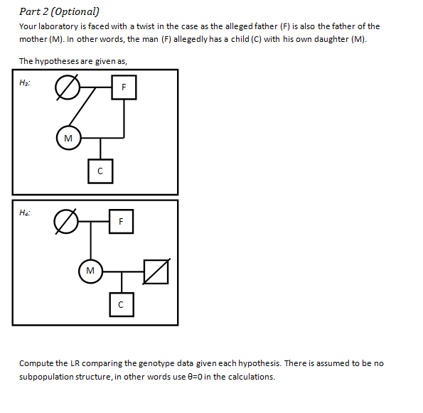
Paper challenge – Part 2

Slide 27
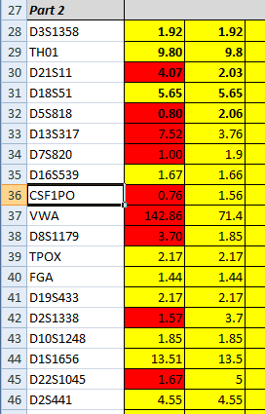
Paper challenge – Part 2
LR should be the same as in Part 1
Slightly different due to mutations
Subpopulations not considered
Deviating results
Three labs got the same deviating results
Only for some markers
In house software/manual/Excel

Slide 28
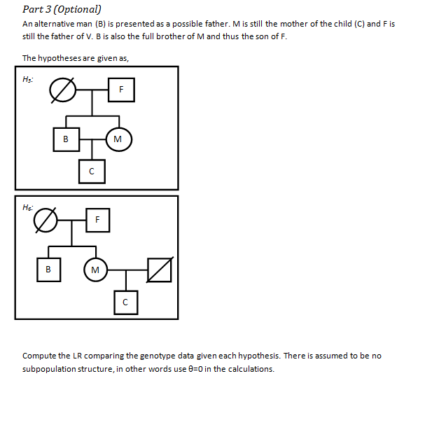
Paper challenge – Part 3

Slide 29
Paper challenge – Part 3
Four mutations required for the Brother as the father
11 Inconclusive, 17 Against and 1 In favor
Deviating results
One lab the same as in Part 2
Three labs got an LR and individual marker LRs completely wrong
In house/Excel/Familias/Patcan
Hypotheses not defined correctly
Minor deviations due to different models for mutations
Autosomal STRs | Mother (M) |  | Child (C ) |  | Brother (B)
 | A1 | A2 | A1 | A2 | A1 | A2 |  | Mutation
D21S11 | 28 | 28 | 28 | 30 | 28 | 29 |  | One (or two) step
D8S1179 | 13 | 14 | 14 | 14 | 13 | 15 |  | One step
D10S1248 | 14 | 15 | 13 | 14 | 12 | 15 |  | One (or three) step
SE33 | 17 | 24.2 | 24.2 | 33.2 | 17 | 24.2 |  | Large mutation

Slide 30
Paper challenge – Part 3
LR for marker with mutations in the same range
One lab had very small LR
Exception SE33 (0.01 to 2.3E-12)
LR for marker D8S1179

Slide 31
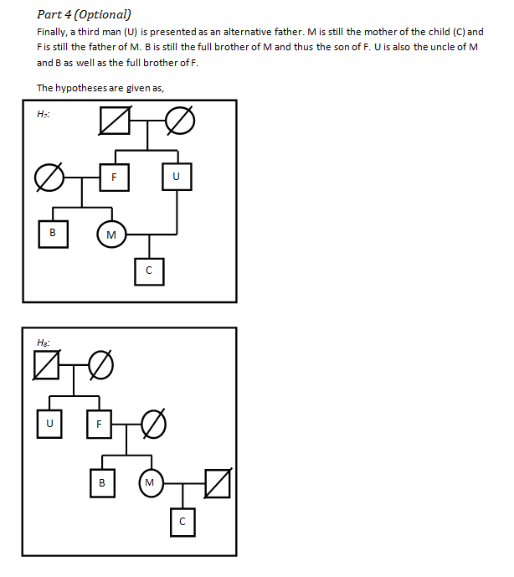
Paper challenge – Part 4

Slide 32
Paper challenge – Part 4
Four mutations required for the Uncle as the father
Deviating results
Two labs got an LR and individual marker LRs completely wrong
Hypotheses not defined correctly?
Minor deviations due to different models for mutations
Conclusions
13 Inconclusive
12 Against
1 In favor
Software hangs/Long computation times
It is normal
Patience is a virtue!
Alleviate the complexity by using a simple mutation model

Slide 33
What happens next year?
We will do both parts of the ESWG proficiency test!
Only one instance to keep contact with
Questionnaire will have a similar apparence
One extra sheet for wet exercise results
Wet exericise will consist of,
Extracted DNA
Diluted EDTA blood on FTA cards (Direct amplification with latest kits)
Paper challenge will be more ”challenging”
Still possible to participate in only one of them
Suggestions for changes/improvements are welcome!

Slide 34
Summary and discussion
What about contacting other labs for assistance?
Subcontractor?
Extended marker analyses?
LR computations?
Agree to share your contact details (Next year)?

Slide 35
A summary of the 2016 ESWG paper challenge
Daniel Kling
ESWG Budapest, 2 September 2016
daniel.kling@fhi.no

