Slide 1
ESWG - Proficiency test 2017
Daniel Kling – Head Organizer
rmdakl@ous-hf.no

Slide 2
Summary
50 labs participated (43 last year)
39 completed paper challenge
Complex case
Results are promising!
Misunderstandings
47 completed wet exercise
Concordant results
Expected variance in statistical results, conclusion same!

Slide 3
Paper challenge - Preliminaries
3 females (children)
The females belong to the same generation
No inbreeding, parents are not related!
Number of possible pedigrees?
Empty pedigree -> All full siblings
Model mutations? (And disregard X-chromsomal sharing)
If no, then 15 pedigrees (autosomal)
If yes, then 25 pedigrees (considering paternal half and maternal half)
Ranged from 1-82 (most 25)

Slide 4
Paper challenge – Potential pedigrees

Slide 5
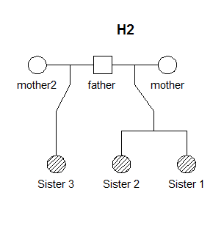
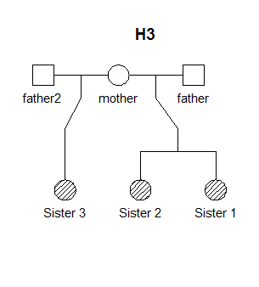
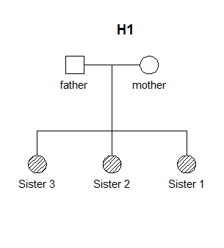
Paper challenge - Hypotheses

Slide 6
Paper challenge - Hypotheses
Cannot be distinguished (unless mutations/linkage)

Slide 7
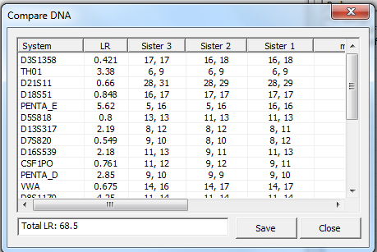
Paper challenge – Autosomal data

Slide 8
Paper challenge – Autosomal data
Requested to compute the LR as P(data|H1)/P(data|H2) and P(data|H3)/P(data|H2)
Suggested combined LR=68.5 (H1 vs H2).
Range 68-100.
Some considered linkage which resulted in LR closer to 100
Suggested conclusion: Inconclusive, more markers needed.
Some in favor, most inconclusive

Slide 9
Paper challenge – Challenges
LR for multiple hypotheses
Scale versus H2
Three likelihoods, two LRs
Three posterior probabilities
Different prior probabilities
$$Posterior Hx= \frac{Prior Hx∗LR Hx}{Sum (Prior Hi∗LR Hx)}$$

Slide 10

Paper challenge – Challenges
$$Posterior H1= \frac{Prior H1∗LR H1}{Sum (Prior Hi∗LR Hi)}=\frac{0.4∗68.5}{0.4∗68.5+1∗0.2+1∗0.4}$$
Hypothesis | Prior | LR (scaled vs H2) | Posterior | Odds
H1 | 0.4 | 68.5 | 0.979 | 137
H2 | 0.2 | 1 | 0.007 | 1
H3 | 0.4 | 1 | 0.014 | 2

Slide 11
Paper challenge – X data
Data from Argus X12 kit
4 clusters of markers
3 STR markers within each cluster
Linkage
Linkage disequilibrium (association of alleles)
Haplotypes
Different approaches
More divergent results

Slide 12
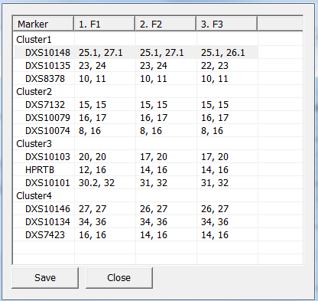
Paper challenge – X data
Cluster | Marker | LR for H1 | LR for H3
Cluster1 | DXS10148 | 0.4589 | 0.9914
 | DXS10135 | 1.062 | 0.654
 | DXS8378 | 1.011 | 0.918
Cluster2 | DXS7132 | 3.126 | 0.6779
 | DXS10079 | 14.55 | 0.7551
 | DXS10074 | 2.9 | 0.9714
Cluster3 | DXS10103 | 4.849 | 1.012
 | HPRTB | 4.187 | 0.01239
 | DXS10101 | 3.095 | 0.2355
Cluster4 | DXS10146 | 8.077 | 1.289
 | DXS10134 | 5.301 | 0.7265
 | DXS7423 | 3.461 | 0.7221
Total |  | 605100 | 0.00059
Total* |  | 214880 | <0.000001
Combined LR ranged from 92-1.8E+17 with most being around 200,000
*No mutations or unobserved haplotypes allowed

Slide 13
Paper challenge – Combined results
Hypothesis | Prior | LR (scaled vs H2) | Posterior | Odds
H1 | 0.4 | 68.5*605100 | >0.9999999 | 82898700
H2 | 0.2 | 1*1 | 1.2E-8 | 1
H3 | 0.4 | 1*0.00059 | 1.4E-11 | 0.00118
All labs reached the same conclusion, expect one that wanted further testing, e.g. mito.

Slide 14
Wet exercise (Typing)
An alleged mother and two children
Norwegian ancestry
Concordant results
Some deviations expected due to different kits
More on final report
Marker naming deviated
TH01 vs THO1

Slide 15
Wet exercise (Statistical)
Hypotheses
Two maternities (duos)
Same father (mother was given) - Optional
Results diverge
Different databases and number of markers used
Same conclusions regarding maternity
Different results regarding same father (they do)
Some used ”unfortunate” markers where the LR=0.5

Slide 16
Questionnaire – Marker systems
Case | nMarkers | nLabs | Commerical
Paternity | 19.5 | 47 | 47
Kinship | 23 | 42 | 38
Crime cases | 16 | 29 | 29
Identification | 19 | 34 | 31
Databasing | 16 | 18 | 18
Twins | 16 | 18 | 18
Bone marrow | 8 | 4 | 3
Diagnosis | 30 | 2 | 1
Other | 15.5 | 7 | 4

Slide 17
Questionnaire – Sequencing
22% own a MPS instrument
38% do sequencing
42% Illumina, 21% PGM, 26% Sanger
Application: mito, kinship, research etc

Slide 18
Questionnaire – Statistical evaluations
Software | nLabs
Familias | 30
DNA-View | 5
Excel | 17
LIMS | 2
Genoproof | 3
FamLink(X) | 13
Other | ?
Validated | nLabs
Supplier | 44
In house | 62

Slide 19
ESWG - Proficiency test 2017
Daniel Kling – Head Organizer
rmdakl@ous-hf.no

